Slide 1
Creating the Cart

Slide 2
Creating the Cart Model
The starting point for the cart feature is a new model class that will be used to gather together the products that the user has selected.
Create a file called cart.model.ts in the src/app/model folder and add the following code:
import { Injectable } from '@angular/core';
import { Product } from './product.model';
@Injectable()
export class Cart {
public lines: CartLine[] = [];
public itemCount = 0;
public cartPrice = 0;
addLine(product: Product, quantity: number = 1): void {
const line = this.lines.find(l => l.product.id === product.id);
if (line !== undefined) {
line.quantity += quantity;
}
else {
this.lines.push(new CartLine(product, quantity));
}
this.recalculate();
}
updateQuantity(product: Product, quantity: number): void {
const line = this.lines.find(l => l.product.id === product.id);
if (line !== undefined) {
line.quantity = Number(quantity);
}
this.recalculate();
}

Slide 3
Creating the Cart Model (continued)
removeLine(id: number): void {
const index = this.lines.findIndex(l => l.product.id === id);
this.lines.splice(index, 1);
this.recalculate();
}
clear(): void {
this.lines = [];
this.itemCount = 0;
this.cartPrice = 0;
}
private recalculate(): void {
this.itemCount = 0;
this.cartPrice = 0;
this.lines.forEach(l => {
this.itemCount += l.quantity;
this.cartPrice += (l.quantity * l.product.price);
});
}
}
export class CartLine {
constructor(public product: Product,
public quantity: number) { }
get lineTotal(): number {
return this.quantity * this.product.price;
}
}

Slide 4
Creating the Cart Model (continued)
Individual product selections are represented as an array of CartLine objects, each of which contains a Product object and a quantity.
The Cart class keeps track of the total number of items that have been selected and their total cost.
There should be a single Cart object used throughout the entire application, ensuring that any part of the application can access the user’s product selections.

Slide 5
Creating the Cart Model (continued)
To achieve this, we are going to make the Cart a service, which means that Angular will take responsibility for creating an instance of the Cart class and will use it when it needs to create a component that has a Cart constructor argument.
This is another use of the Angular dependency injection feature, which can be used to share objects throughout an application.
The @Injectable decorator, which has been applied to the Cart class, indicates that this class will be used as a service.

Slide 6
Creating the Cart Model (continued)
Modify the model.module.ts file in the src/app/model folder with the highlighted code:
import { NgModule } from '@angular/core';
import { ProductRepository } from './product.repository';
import { StaticDataSource } from './static.datasource';
import { Cart } from './cart.model';
@NgModule({
providers: [ProductRepository, StaticDataSource, Cart]
})
export class ModelModule { }

Slide 7
Creating the Cart Summary Components
Components are the essential building blocks for Angular applications because they allow discrete units of code and content to be easily created.
The SportsStore application will show users a summary of their product selections in the title area of the page, which we are going to implement by creating a component.

Slide 8
Creating the Cart Summary Components (continued)
Create a file called cartSummary.component.ts in the src/app/store folder and add the following code:
import { Component } from '@angular/core';
import { Cart } from '../model/cart.model';
@Component({
selector: 'cart-summary',
templateUrl: 'cartSummary.component.html'
})
export class CartSummaryComponent {
constructor(public cart: Cart) { }
}

Slide 9
Creating the Cart Summary Components (continued)
To provide the component with a template, create a file called cartSummary.component.html in the src/app/store folder and add the following code:
<div class="float-right">
<small>
Your cart:
<span *ngIf="cart.itemCount > 0">
{{ cart.itemCount }} item(s)
{{ cart.cartPrice | currency: "USD":"symbol":"2.2-2" }}
</span>
<span *ngIf="cart.itemCount == 0">
(empty)
</span>
</small>
<button
class="btn btn-sm bg-dark text-white"
[disabled]="cart.itemCount == 0"
>
<i class="fa fa-shopping-cart"></i>
</button>
</div>

Slide 10
Creating the Cart Summary Components (continued)
We need to register the new component with the store feature module. Modify the store.module.ts file in the src/app/store folder with the following highlighted changes:
import { NgModule } from '@angular/core';
import { BrowserModule } from '@angular/platform-browser';
import { FormsModule } from '@angular/forms';
import { ModelModule } from '../model/model.module';
import { StoreComponent } from './store.component';
import { CounterDirective } from './counter.directive';
import { CartSummaryComponent } from './cartSummary.component';
@NgModule({
imports: [ModelModule, BrowserModule, FormsModule],
declarations: [StoreComponent, CounterDirective, CartSummaryComponent],
exports: [StoreComponent, CounterDirective, CartSummaryComponent]
})
export class StoreModule { }

Slide 11
Integrating the Cart into the Store
The store component is the key to integrating the cart and the cart widget into the application.
Update the store.component.ts file in the src/app/store folder so that its constructor has a Cart parameter and defines a method that will add a product to the cart:
import { Component } from '@angular/core';
import { Product } from '../model/product.model';
import { ProductRepository } from '../model/product.repository';
import { Cart } from "../model/cart.model";
@Component({
selector: 'store',
templateUrl: 'store.component.html'
})
export class StoreComponent {
public selectedCategory = null;
public productsPerPage = 4;
public selectedPage = 1;
constructor(private repository: ProductRepository,
private cart: Cart) { }

Slide 12
Integrating the Cart into the Store (continued)
get products(): Product[] {
const pageIndex = (this.selectedPage - 1) * this.productsPerPage;
return this.repository.getProducts(this.selectedCategory)
.slice(pageIndex, pageIndex + this.productsPerPage);
}
get categories(): string[] {
return this.repository.getCategories();
}
changeCategory(newCategory?: string): void {
this.selectedCategory = newCategory;
}
changePage(newPage: number): void {
this.selectedPage = newPage;
}
changePageSize(newSize: number): void {
this.productsPerPage = Number(newSize);
this.changePage(1);
}
get pageCount(): number {
return Math.ceil(this.repository.getProducts(this.selectedCategory).length / this.productsPerPage);
}
addProductToCart(product: Product): void {
this.cart.addLine(product);
}
}

Slide 13
Integrating the Cart into the Store (continued)
To complete the integration of the cart into the store component, we will add the element that will apply the cart summary component to the store.component.html file in the src/app/store folder. Also, we will add a button under the product description with the event binding that calls the addProductToCart method:
<div class="container-fluid">
<div class="row">
<div class="col bg-dark text-white">
<a class="navbar-brand">SPORTS STORE</a>
<cart-summary></cart-summary>
</div>
</div>
...
<div class="card-text bg-white p-1">
{{ product.description }}
<button class="btn btn-success btn-sm float-right"
(click)="addProductToCart(product)">
Add To Cart
</button>
</div>

Slide 14
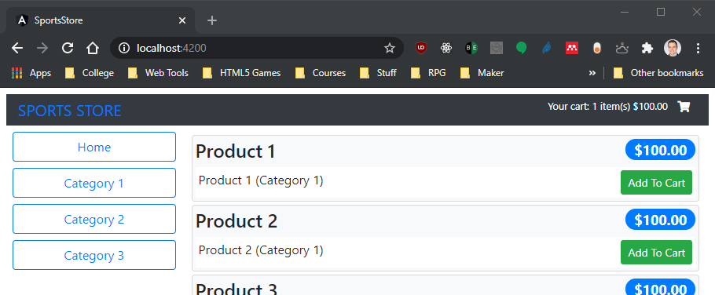

Integrating the Cart into the Store (continued)
The result is a button for each product that adds it to the cart. The full cart process isn’t complete yet, but you can see the effect of each addition in the cart summary at the top of the page.

Slide 15
Using the RESTful Web Service
Now that some SportsStore functionality is in place, it is time to replace the dummy data source with one that gets its data from the RESTful web service that was created during the project setup.
Create the data source, by adding a file called rest.datasource.ts in the src/app/model folder with the following code:
import { Injectable } from '@angular/core';
import { HttpClient } from '@angular/common/http';
import { Observable } from 'rxjs';
import { Product } from './product.model';
import { Cart } from './cart.model';
const PROTOCOL = 'http';
const PORT = 3500;
@Injectable()
export class RestDataSource {
baseUrl: string;
constructor(private http: HttpClient) {
this.baseUrl = `${PROTOCOL}://${location.hostname}:${PORT}/`;
}
getProducts(): Observable<Product[]> {
return this.http.get<Product[]>(this.baseUrl + 'products');
}
}

Slide 16
Using the RESTful Web Service (continued)
Angular provides a built-in service called HttpClient that is used to make HTTP requests.
The RestDataSource constructor receives the HttpClient service and uses the global location object provided by the browser to determine the URL that the requests will be sent to, which is port 3500 on the same host that the application has been loaded from.
The methods defined by the RestDataSource class correspond to the ones defined by the static data source but are implemented using the HttpClient service.
Note: When obtaining data via HTTP, it is possible that network congestion or server load will delay the request and leave the user looking at an application that has no data. We will fix this problem in a future lesson.

Slide 17
Applying the Data Source
To complete this lesson, we are going to apply the RESTful data source by reconfiguring the application so that the switch from the dummy data to the REST data is done with changes to a single file.
Make the highlighted changes to the model.module.ts file in the src/app/model folder:
import { NgModule } from '@angular/core';
import { ProductRepository } from './product.repository';
import { StaticDataSource } from './static.datasource';
import { Cart } from './cart.model';
import { RestDataSource } from './rest.datasource';
import { HttpClientModule } from '@angular/common/http';
@NgModule({
imports: [HttpClientModule],
providers: [ProductRepository, StaticDataSource, Cart,
{provide: StaticDataSource, useClass: RestDataSource}]
})
export class ModelModule { }

Slide 18
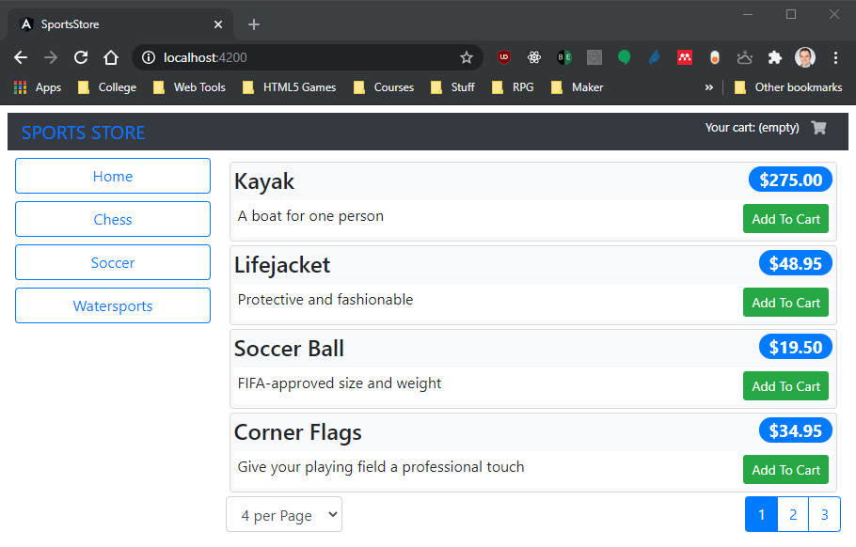
Applying the Data Source (continued)
When all the changes have been saved and the browser reloads the application, you will see the dummy data has been replaced with the data obtained via HTTP:

